Slide 1

Aging in British Columbia
Dashboard Overview
Ranjit Sundaramurthi
July 31, 2023
Img: https://www.freepik.com/

Slide 2
Objective
Sustaining the provincial economy with insights on the population aging and future recommendations for the government.

Slide 3
Definition
Dependency:
“the state of relying on or being controlled by someone or something else”
Demographically, dependency ratio is the proportion of the dependant population (non-earning) to the independent (earning population)

Slide 4
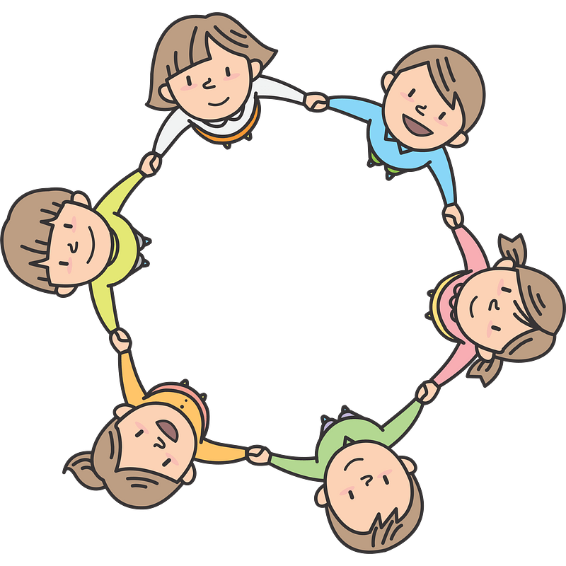

Significance
Dependency ratio is a influential factor in the economic health of province
Children dependants
An Investment for the future
Need expenditure on resources - Education , Healthcare.
Elderly dependants
Wisdom for the present
A declining resource for future
Need expenditure on resources - Healthcare , Pension

Slide 5
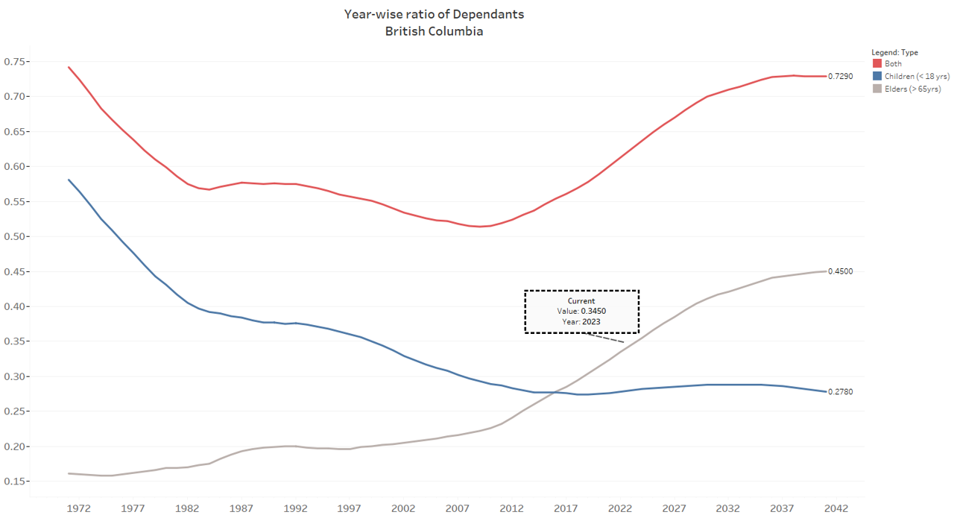
Dependency ratio in British Columbia (B.C.)
The ratio of Elderly dependents exceeds the the ratio of Children dependents.
Nearly 73% of B.C. population will be dependent by 2041.
45% of population will be elderly

Slide 6




Impact of high elderly dependency ratio
Decrease in tax income to provincial government
Increase in Healthcare expenses
Stagnation of cultural and economic change
Surprising Impact!
(More on that later)

Slide 7
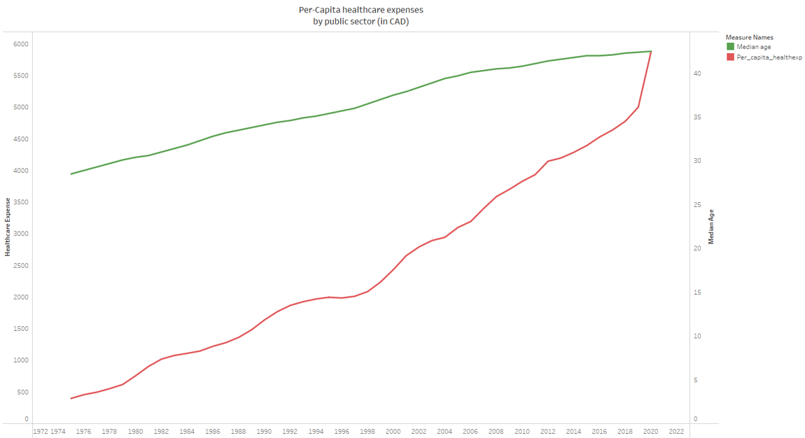
Healthcare in B.C.
General trend is a progressive increase in expenditure for all age-groups.
The spike in 2020 is due to the Covid pandemic.

Slide 8

Surprising Impact
Voter turnout, often overlooked factor is be influenced heavily by dependency ratio!

Slide 9
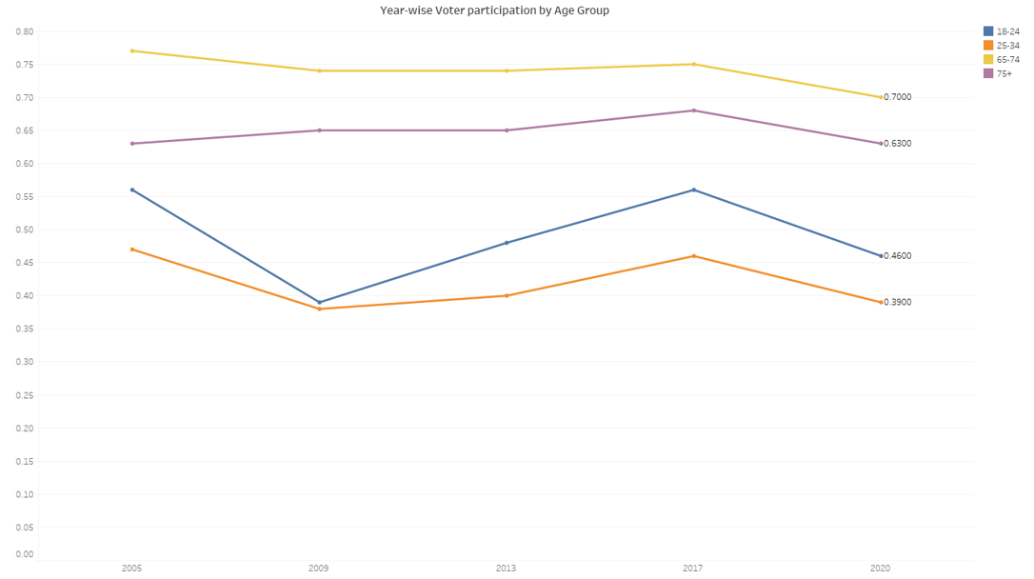
Voter Participation
63% of 75+ yrs registered elders, participated in 2020 General Elections
46% of 18-24 yrs registered persons, participated in 2020 General Elections.

Slide 10
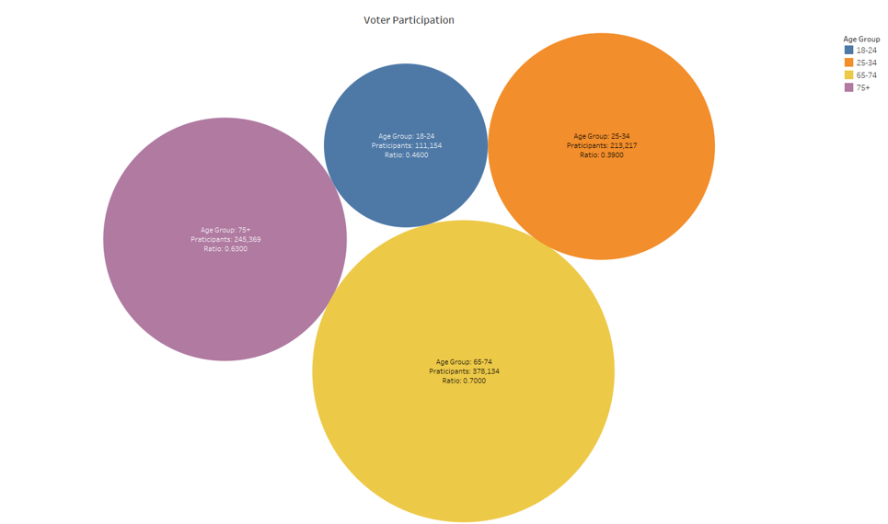
Voter Participation in 2020
Customize the selected age groups in the DASHBOARD for more insights

Slide 11
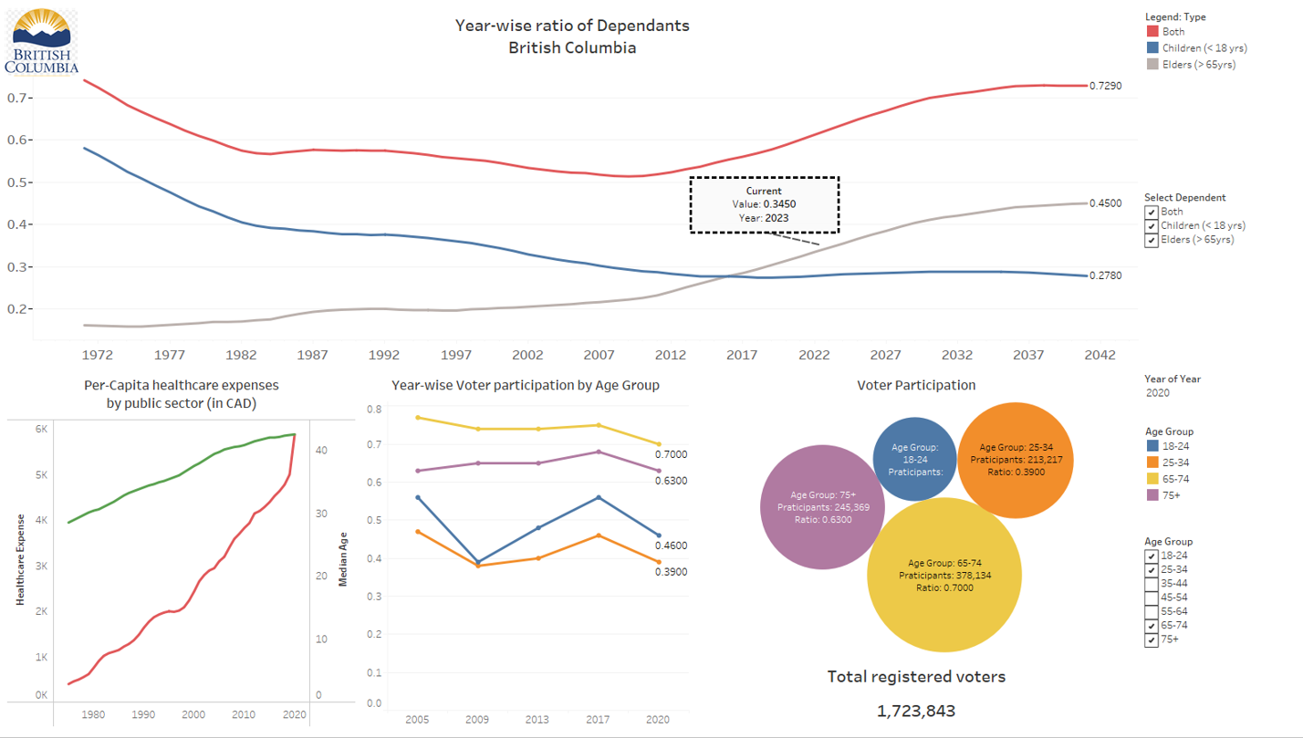
Dashboard
Filter by dependent type
Filter by year
Filter by age group

Slide 12
Key Takeaways
73% of the population in B.C. will be dependent by 2041. 45% of the population will be elderly of age 65+ yrs.
Per-capita Public Healthcare expenditure in 2020 was nearly 6000 CAD. It will increase with increasing elderly dependency ratio.
Children promise a future of continuous revenue. Income from taxes in future, will decrease with a decreasing Children dependency ratio.
Elders participation in general elections in high, future government mandates and popular decision might revolve around the interests of the Elders.
There is a risk of averseness to change, with a dominance of elderly population in future.

Slide 13
THANK YOU

